Slide 1
E/R To Relational Conversion, Create Tables
E/R To Relational Conversion,
Create Database Tables
  Chapter 3
  Carlos Coronel, Steven Morris - Database Systems: Design, Implementation & Management, 13th edition, CENGAGE Learning, 2019, ISBN-13: 978-1337627900.
Database Systems
Robert Dollinger 2021

Slide 2
E/R To Relational Conversion, Create Tables
  Objectives:
  1. Introduce the rules to convert an E/R Model into a relational schema.
  2. Introduce the syntax for creating database tables; examples.
  Main topics:
  - E/R to relational conversion rules;
  - Implementation of a relational schema;
  - CREATE TABLE Syntax;
  - Examples.
Database Systems
Robert Dollinger 2021

Slide 3
E/R To Relational Conversion Rules
  An E/R Diagram can be converted into a Relational Schema by the following rules:
  1) Converting Entity Types
    Strong (stand alone) Entities - each entity converts into a relation (represented as a table). The name and the set of attributes of the relation are the name and attributes of the entity. The key of the entity becomes the placeholder primary key of the relation.
    Weak Entities – add the key attributes from the parent entity into the relation representing the weak entity. The primary key of the weak entity is a composite of the weak entity key and the parent entity key.
    Sub-Types – follow the same rules as for weak entities.
Database Systems
Robert Dollinger 2021

Slide 4
E/R To Relational Conversion Rules
  2) Converting Relationships
    Binary Relationships
      One-to-One Relationship – two options are possible:
        combine into one single relation the two entity members of the one-to-one relationship;
        add a foreign key to one of the member entities of the binary one-to-one relationship;
      One-to-Many Relationship – two options are possible:
        add a foreign key to one of the member entities of the binary one-to-many relationship;
        create a separate relation (also called link-table) if the relationship has own attributes. Add to the table a foreign key for both member entities in the relationship.
      Many-to-Many Relationship – create a separate relation for all binary many-to-many relationships. Add to the table a foreign key for both member entities in the relationship.
    Higher Arity Relationships (ternary and above)
      Create a relation for all ternary or higher arity relationships. Add to the table a foreign key for all member entities in the relationship.
Database Systems
Robert Dollinger 2021

Slide 5
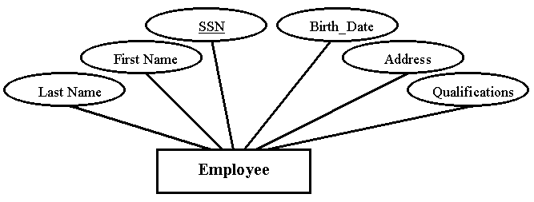
E/R To Relational Conversion – Strong Entity
E/R Model
  Relational Schema
  Employee(SSN, First_Name, Last_Name, Birth_Date, Address, Qualifications)
Database Systems
Robert Dollinger 2021

Slide 6
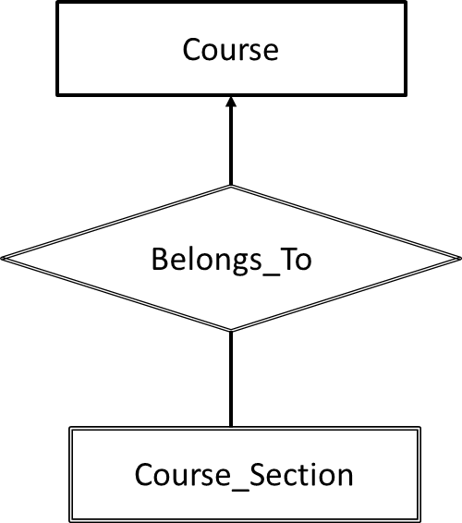
E/R To Relational Conversion – Weak Entity
E/R Model
  Relational Schema
  Course(Course#, Name, Description, #Credits)
  Course_Section(Course#, Section#, Year, Term, Enrollment)
Database Systems
Robert Dollinger 2021

Slide 7
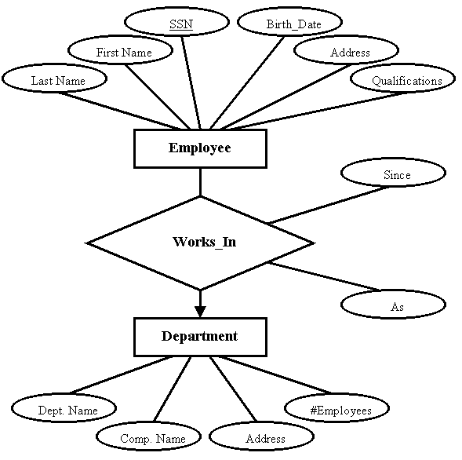
E/R To Relational Conversion – One to Many Relationship with Own Attributes
E/R Model
  Relational Schema
  Employee(SSN, First_Name, Last_Name, Birth_Date, Address, Qualifications);
  Department(Dept_Name, Comp_Name, Address, #Employees);
  Works_In(SSN, Dept_Name, Since, As).
Database Systems
Robert Dollinger 2021

Slide 8
E/R To Relational Conversion – Ternary Relationship
E/R Model
  Relational Schema
  Teacher(Teacher_ID, …);
  Student(Student_ID, …);
  Grad_Project(Grad_Project_ID, …);
  Work(Teacher_ID,
  Student_ID,
  Grad_Project_ID, …);
  Or
  Work(Work_ID,
  Teacher_ID,
  Student_ID,
  Grad_Project_ID, …).
Teacher
Work
Grad_Project
Student
Database Systems
Robert Dollinger 2021

Slide 9
Implement Relational Schema
  Implementing Relational Schema on Target DBMS
  Implementation of the relational schema into one of the available DBMS, mainly consists of creating the corresponding tables as well as specification of constraints.
  The process involves several design decisions:
  data types, sizes and formats of attributes;
  which of the candidate keys is going to be the primary key and which will be just candidate keys;
  which strategy to use for each foreign key connection in order to enforce referential integrity;
  which of the (semantic) constraints can be implemented declaratively and which are going to be handled through triggers.
  Each of these decisions requires some knowledge of the target DBMS and the tools made available through it!
Database Systems
Robert Dollinger 2021

Slide 10
Create Tables
Creating Tables
Can be done in two ways:
- by code - issuing a CREATE TABLE instruction for each table – requires knowledge of the syntax;
- interactively - using a specialized client interface if provided by the DBMS or a third party.
Steps to follow:
- define table name;
- define attribute names, data types, defaults, null status;
- define primary key;
- define candidate key(s);
- define foreign key(s) if referenced table(s) already available, if not postpone;
- define other constraints.
Database Systems
Robert Dollinger 2021

Slide 11
E/R To Relational Conversion, Create Tables
  Simplified Syntax for CREATE TABLE Statement
  CREATE TABLE table_name (
  < column_or_table_constraint definition > [,…n]
  )
  < column_or_table_constraint_definition > ::= {
  < column_definition > | < table constraint_definition >
  }
  < column_definition > ::= column_name data_type [size]
  [attributes] [column_constraints]
  < table_constraint_definition > ::= [CONSTRAINT][constraint_name]
  {PRIMARY KEY|FOREIGN KEY|CHECK|UNIQUE}
  constraint_definition
Database Systems
Robert Dollinger 2021

Slide 12
E/R To Relational Conversion, Create Tables
  Simplified Syntax for CREATE TABLE Statement
  Remarks:
  1) Syntactically a CREATE TABLE statement contains a comma separated list of column definitions or constraint definitions.
  2) A column definition is composed of: a column name, data type and an optional size.
  3) In addition a column definition may also optionally specify a list of column attributes (like: NULL, NOT NULL, DEFAULT etc.) and a column constraint, if the constraint refers exclusively to the current column.
  4) Constraints involving several columns in a table must be expressed separately as table constraints. There 4 types of constraints:
  PRIMARY KEY, FOREIGN KEY, CHECK, UNIQUE.
  5) Constraint syntax is specific for each constraint type.
Database Systems
Robert Dollinger 2021

Slide 13
Create Table Examples
  1) Table with computed column:
  CREATE TABLE Person (
  ID int IDENTITY,
  Name varchar(15),
  Birthyear int DEFAULT 1950,
  -- computed column
  Age AS DATEPART(yy,GETDATE())-Birthyear
  )
Database Systems
Robert Dollinger 2021

Slide 14
Create Table Examples
  2) Table with computed column and check constraint as part of column definition:
  CREATE TABLE Person (
  ID int IDENTITY PRIMARY KEY,
  Name varchar(15) UNIQUE NOT NULL,
  --check constraint as part of attribute definition
  Birthyear int DEFAULT 1950 CHECK (Birthyear >1900 AND
  Birthyear <DATEPART(yy,GETDATE())),
  Age AS DATEPART(yy,GETDATE())-Birthyear)
Database Systems
Robert Dollinger 2021

Slide 15
Create Table Examples
  3) Foreign key as column constraint referencing primary key:
  CREATE TABLE Loan (
  ID int IDENTITY PRIMARY KEY,
  Person_ID int FOREIGN KEY REFERENCES Person(ID),
  Title varchar(30) NOT NULL)
  or
  CREATE TABLE Loan (
  ID int IDENTITY PRIMARY KEY,
  Person_ID int REFERENCES Person(ID),
  Title varchar(30) NOT NULL)
Database Systems
Robert Dollinger 2021

Slide 16
Create Table Examples
  4) Foreign key as column constraint referencing candidate key:
  CREATE TABLE Loan (
  ID int IDENTITY PRIMARY KEY,
  Person_Name varchar(15) FOREIGN KEY REFERENCES Person(Name),
  Title varchar(30) NOT NULL)
  or
  CREATE TABLE Loan (
  ID int IDENTITY PRIMARY KEY,
  Person_Name varchar(15) REFERENCES Person(Name),
  Title varchar(30) NOT NULL)
Database Systems
Robert Dollinger 2021

Slide 17
Create Table Examples
  The default behavior of the foreign key is illustrated by the sample operations below (default strategy is restrict):
  --insert persons first and loans after
  --inserts in the Person table - referenced
  INSERT Person VALUES ('James', 1995)
  INSERT Person VALUES ('Jonathan', 1925)
  --inserts in the Loan table, foreign key values
  --execute twice and see result
  INSERT Loan VALUES ('James', 'Home')
  INSERT Loan VALUES ('James', 'Car')
  INSERT Loan VALUES ('James', 'Boat’)
  --verify
  SELECT * FROM Person
  SELECT * FROM Loan
Database Systems
Robert Dollinger 2021

Slide 18
Create Table Examples
  --these inserts in the Loan table will fail
  --foreign key constraint violation
  INSERT Loan VALUES ('Jessica', 'Home')
  INSERT Loan VALUES ('Jessica', 'Car')
  INSERT Loan VALUES ('Jessica', 'Boat')
  --this delete from the Person table will fail
  --default strategy is restrict
  DELETE FROM Person WHERE Name='James'
  --this update in the Person table will fail
  --default strategy is restrict - cannot change name if it has loans
  UPDATE Person SET Name='Jessica' WHERE Name='James’
  --verify
  SELECT * FROM Person
  SELECT * FROM Loan
Database Systems
Robert Dollinger 2021

Slide 19
Create Table Examples
  --this update in the Person table will succeed
  --name is not referenced
  UPDATE Person SET Name='Jessica' WHERE Name='Jonathan'
  --now this insert in the Loan table will succeed
  INSERT Loan VALUES ('Jessica', 'Home')
  --now this update to the Loan table will succeed
  UPDATE Loan SET Person_Name='Jessica’
  WHERE Person_Name='James' and Title='Boat’
  --verify
  SELECT * FROM Person
  SELECT * FROM Loan
Database Systems
Robert Dollinger 2021

Slide 20
Create Table Examples
  5) Foreign key as column constraint referencing candidate key – cascade strategy:
  CREATE TABLE Loan (
  ID int IDENTITY PRIMARY KEY,
  Person_Name varchar(15) FOREIGN KEY REFERENCES Person(Name)
  ON UPDATE CASCADE ON DELETE CASCADE,
  Title varchar(30) NOT NULL)
  Note:
  In this case the strategy is to cascade both for update and for delete operations.
  Deleting a person will delete all her loans.
  Changing the name of a person will propagate to the Loan table changing the name in all dependent loans.
Database Systems
Robert Dollinger 2021

Slide 21
Create Table Examples
  The behavior of the foreign key with the cascade strategy for updates and deletes is illustrated by the sample operations below:
  --inserts in the Person table - referenced
  INSERT Person VALUES ('James', 1995)
  INSERT Person VALUES ('Jonathan', 1925)
  --inserts in the Loan table, foreign key values
  --execute twice and see result
  INSERT Loan VALUES ('James', 'Home')
  INSERT Loan VALUES ('James', 'Car')
  INSERT Loan VALUES ('James', 'Boat')
Database Systems
Robert Dollinger 2021

Slide 22
Create Table Examples
  --these inserts in the Loan table will fail
  --foreign key constraint violation
  INSERT Loan VALUES ('Jessica', 'Home')
  INSERT Loan VALUES ('Jessica', 'Car')
  INSERT Loan VALUES ('Jessica', 'Boat')
  --this delete from the Person table will succeed and
  --also delete from table Loan the 3 loans James has
  --strategy is cascade
  DELETE FROM Person WHERE Name='James’
  --James and his loans are all deleted
  SELECT * FROM Person
  SELECT * FROM Loan
Database Systems
Robert Dollinger 2021

Slide 23
Create Table Examples
  --let's have them back
  INSERT Person VALUES ('James', 1995)
  INSERT Loan VALUES ('James', 'Home')
  INSERT Loan VALUES ('James', 'Car')
  INSERT Loan VALUES ('James', 'Boat')
  --this update in the Person table will succeed
  --strategy is cascade
  --Jessica is the new James both in the Person and in the Loan tables
  UPDATE Person SET Name='Jessica' WHERE Name='James'
  --verify
  SELECT * FROM Person
  SELECT * FROM Loan
Database Systems
Robert Dollinger 2021

Slide 24
Create Table Examples
  6) Foreign key as column constraint referencing candidate key - non-identifying case:
  CREATE TABLE Loan (
  ID int IDENTITY PRIMARY KEY,
  Person_Name varchar(15) FOREIGN KEY REFERENCES Person(Name)
  ON UPDATE SET NULL ON DELETE SET NULL,
  Title varchar(30) NOT NULL)
  Note:
  In this case the strategy is to cascade both for update and for delete operations.
  Deleting a person will set the name to NULL in all her loans.
  Changing the name of a person will propagate to the Loan table changing the name in all dependent loans to NULL.
Database Systems
Robert Dollinger 2021

Slide 25
Create Table Examples
  The behavior of the foreign key with the cascade strategy for updates and deletes is illustrated by the sample operations below:
  --inserts in the Person table - referenced
  INSERT Person VALUES ('James', 1995)
  INSERT Person VALUES ('Jonathan', 1925)
  --inserts in the Loan table, foreign key values
  --execute twice and see result
  INSERT Loan VALUES ('James', 'Home')
  INSERT Loan VALUES ('James', 'Car')
  INSERT Loan VALUES ('James', 'Boat')
Database Systems
Robert Dollinger 2021

Slide 26
Create Table Examples
  --these inserts in the Loan table will fail
  --foreign key constraint violation
  INSERT Loan VALUES ('Jessica', 'Home')
  INSERT Loan VALUES ('Jessica', 'Car')
  INSERT Loan VALUES ('Jessica', 'Boat')
  --this delete from the Person table will succeed and
  --also will set the name in the 3 loans James has to NULL
  --strategy is cascade set to NULL
  DELETE FROM Person WHERE Name='James’
  --James and his loans are all deleted
  SELECT * FROM Person
  SELECT * FROM Loan
Database Systems
Robert Dollinger 2021

Slide 27
Create Table Examples
  --let's have them back
  INSERT Person VALUES ('James', 1995)
  UPDATE Loan SET Person_Name= 'James' WHERE Person_Name IS NULL
  --this update in the Person table will succeed
  --but it will set to NULL the name in the loans James had
  --strategy is cascade set to NULL
  UPDATE Person SET Name='Jessica' WHERE Name='James'
  --if we want to assign those loans to Jessica,
  --we need to execute the following
  UPDATE Loan SET Person_Name= 'Jessica' WHERE Person_Name IS NULL
  --verify
  SELECT * FROM Person
  SELECT * FROM Loan
Database Systems
Robert Dollinger 2021

Slide 28
Create Table Examples
  7) Primary key and foreign key as table constraints:
  CREATE TABLE Referenced (
  C1 int,
  C2 int,
  PRIMARY KEY (C1,C2)
  )
  CREATE TABLE Reference (
  RC1 int,
  RC2 int,
  FOREIGN KEY (RC1,RC2) REFERENCES Referenced (C1,C2)
  )
Database Systems
Robert Dollinger 2021

Slide 29
Create Table Examples
  8) Multi-column candidate key declared as table constraint:
  CREATE TABLE Student(
  StudentID CHAR(8) PRIMARY KEY,
  Firstname varchar(15),
  Lastname varchar(15),
  Birthdate DATETIME,
  Major VARCHAR(15),
  UNIQUE (Firstname, Lastname)
  )
Database Systems
Robert Dollinger 2021

Slide 30
Create Table Examples
  9) Check constraints as table constraints:
  CREATE TABLE Constrained (
  C1 int,
  CHECK (C1>C2+10),
  C2 int,
  PRIMARY KEY (C1,C2),
  CHECK (C1<C2)
  )
  Can you insert any rows in this table?
Database Systems
Robert Dollinger 2021

Slide 31
Create Table Examples
  Exercises (MSSQL)
  1) Indicate which of the following instructions are correct and which are not. Explain!
  a) CREATE TABLE T(A int PRIMARY KEY, B int PRIMARY KEY)
  CREATE TABLE T(CHECK (A<B),A int, B int)
  CREATE TABLE T (A int PRIMARY KEY FOREIGN KEY REFERENCES T(A))
  CREATE TABLE T(A int IDENTITY PRIMARY KEY)
  CREATE TABLE T(A int IDENTITY (0,0))
  CREATE TABLE T(A int IDENTITY, B int IDENTITY)
Database Systems
Robert Dollinger 2021

Slide 32
Create Table Examples
  2) CREATE TABLE Referenced (
  C1 varchar(10),
  C2 varchar(10),
  PRIMARY KEY (C1,C2)
  )
  CREATE TABLE Reference (
  RC1 varchar(10),
  RC2 varchar(10),
  FOREIGN KEY (RC1,RC2) REFERENCES Referenced (C1,C2)
  )
  Create the tables above by running the scripts.
  Add rows: One:Egg and Two:Eggs to both tables. Replicate rows several times in the table named Reference. Set foreign key constraint mode to Cascade.
  Change Eggs to Apples in Reference. Explain what happens!
  Change Eggs to Apples in Referenced. Explain what happens!
Database Systems
Robert Dollinger 2021

Slide 33
Create Table Examples
  3) Let table T be defined as:
  CREATE TABLE T (
  A int PRIMARY KEY FOREIGN KEY REFERENCES T(B),
  B int UNIQUE FOREIGN KEY REFERENCES T(A)
  )
  Is this definition correct?
  If yes, explain what happens when executing the following inserts:
  INSERT T values (2,2)
  INSERT T values (1,3)
  Could you indicate a general form of the rows acceptable in table T?
Database Systems
Robert Dollinger 2021

Slide 34
Create Table Examples
  4) Let T be defined as follows:
  CREATE TABLE T(
  A tinyint IDENTITY (0,128),
  B int)
  Execute the subsequent inserts:
  INSERT T values (1)
  INSERT T values (2)
  INSERT T values (3)
  Explain what happens!
Database Systems
Robert Dollinger 2021

Slide 35
?
?
?
?
?
?
?
?
?
?
?
?
?
?
Database Systems
Robert Dollinger 2021

